Slide 1
Run ons and Fragments

Slide 2
FRAGMENTS
CLICK HERE FOR a video explaining fragments

Slide 3
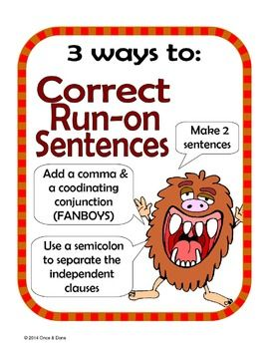
RUN ON SENTENCES
CLICK HERE for a video to explain run on sentences
My dad is an engineer. He wants me to become one too
My dad is an engineer, and he wants me to become one too.
My dad is an engineer; he wants me to become one too.
My dad is an an engineer; therefore, he wants me to become one too. (Often we use a TRANSITION word w/ semicolons. Note: transitions are NOT conjuctions)

Slide 4
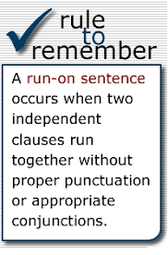
This PowerPoint that I found online does an excellent job of explaining run ons and how to fix them. It is well worth your time.
I love it!
CLICK HERE!!!!

Slide 5
Check for Understanding
Rags to Riches GAME
CLICK HERE to Play!

Slide 6
Need more review?
CLICK HERE!

